Slide 1
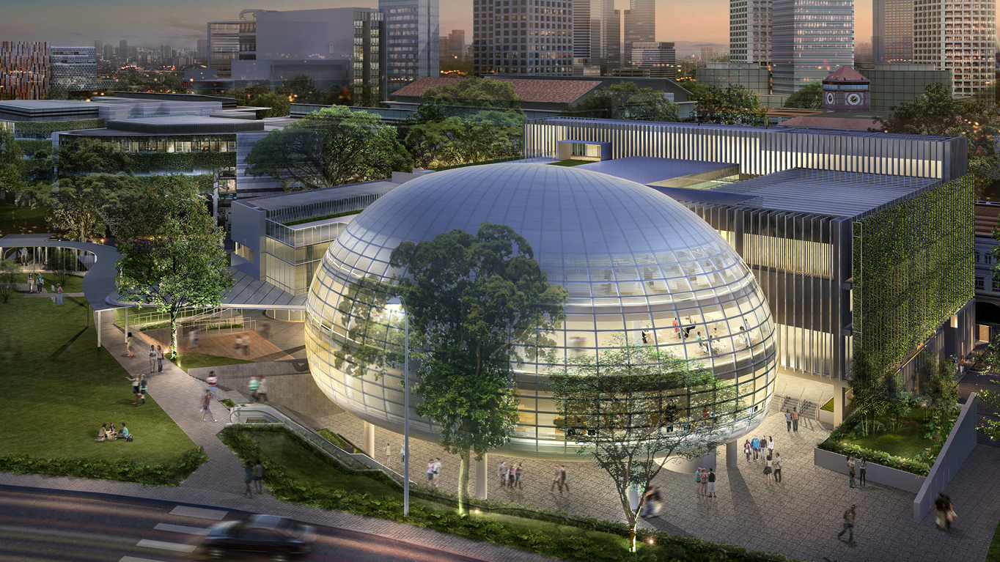
Singapore Management University
Classroom Technology Sharing Session
Presented By:
Gerard Chua
Learning Space Technology Services

Slide 2
Objective
To Enable the Users of SMU’s Seminar Rooms and Classrooms

Slide 3
OUTLINE
Outline:
Introduction of Rooms
Starting Up & Touch Panel
Lectern’s Equipment
Microphone
Shutting Down
Getting HELP
Hybrid Teaching

Slide 4
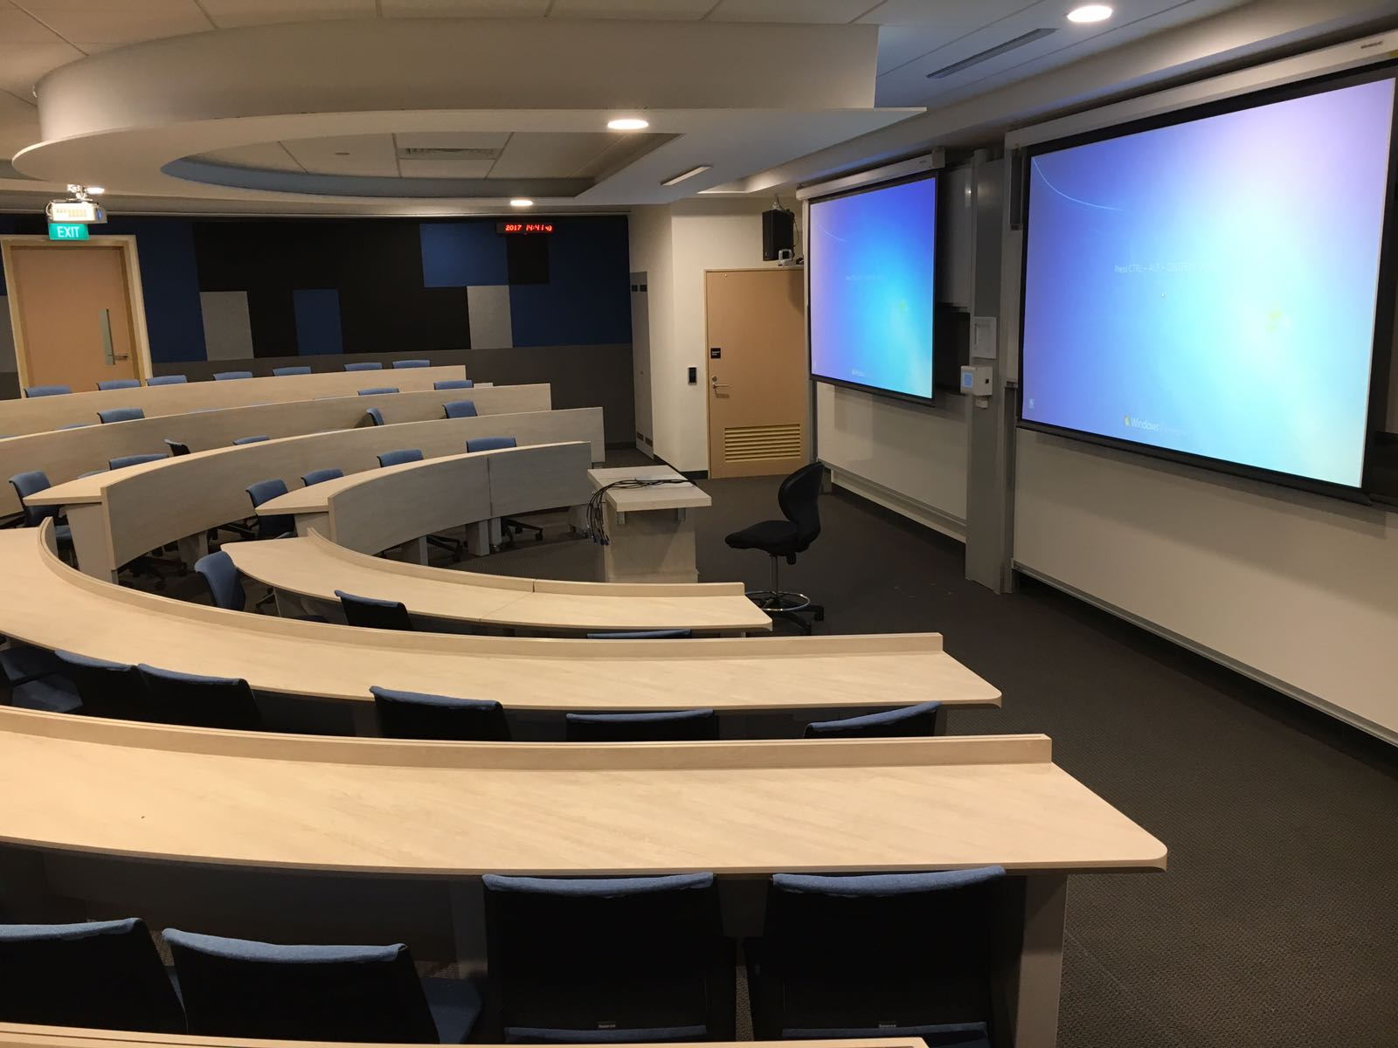
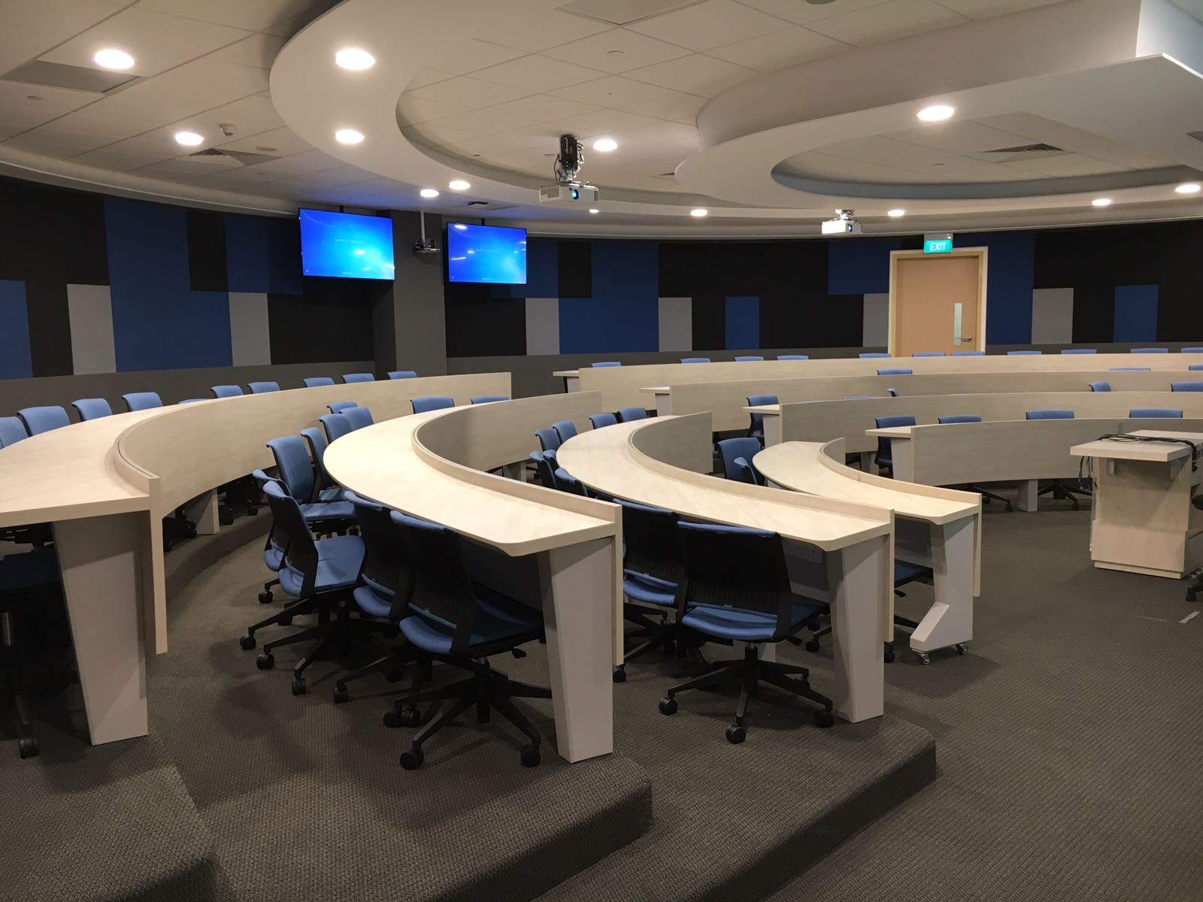
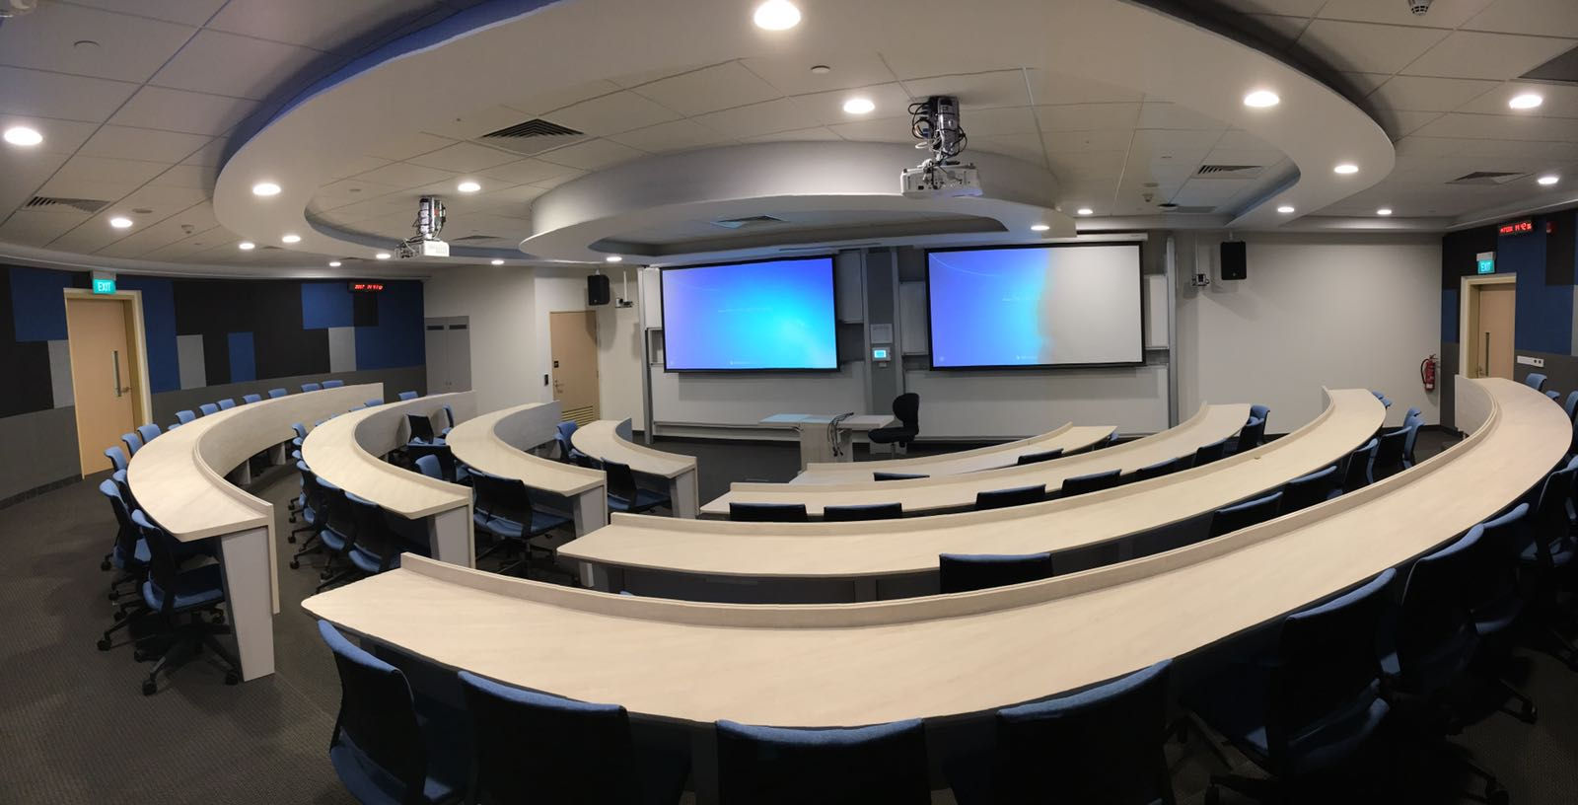
Tiered Seminar Room

Slide 5
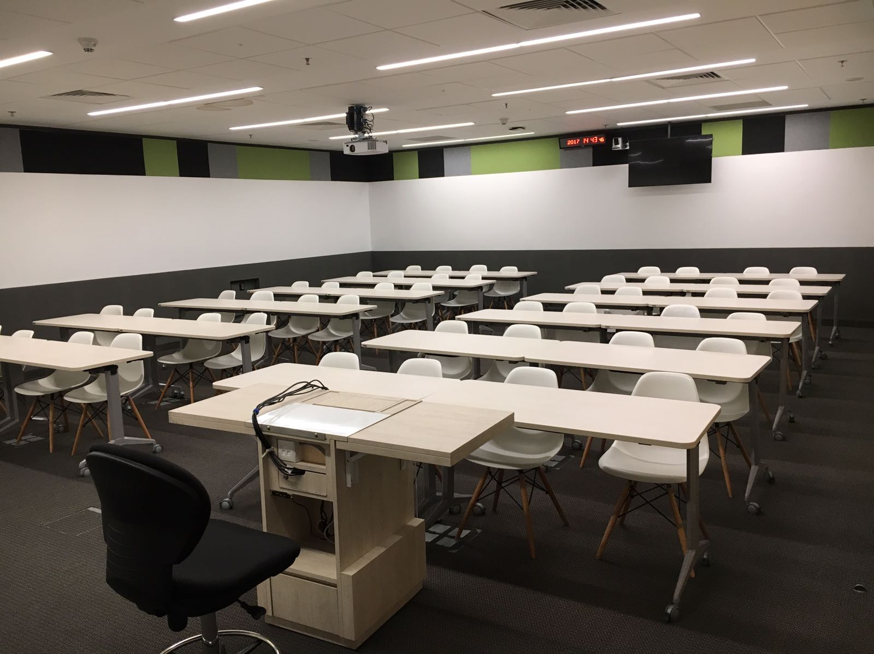
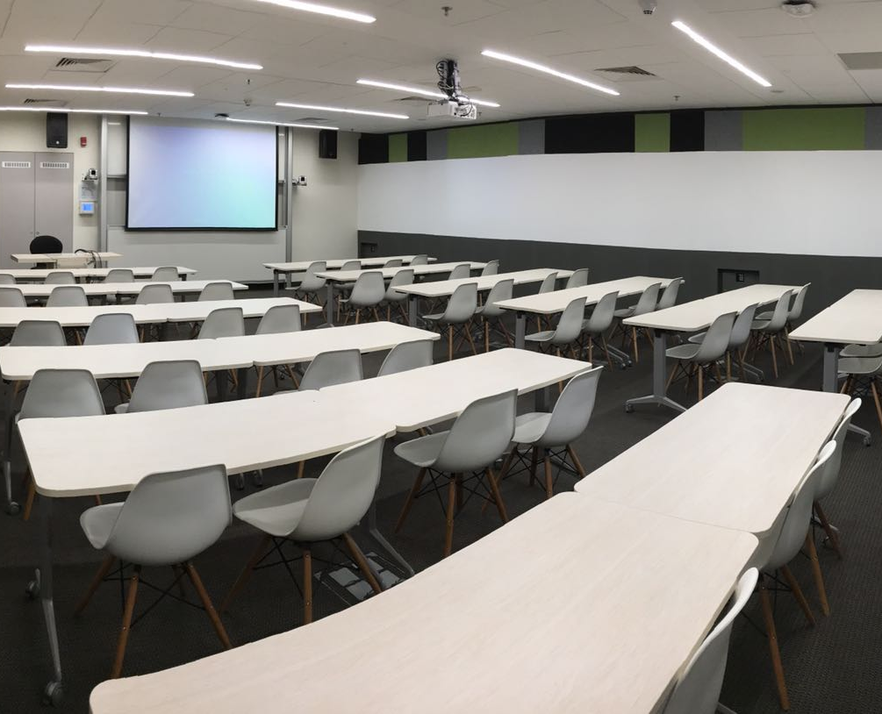
Flat Classroom

Slide 6
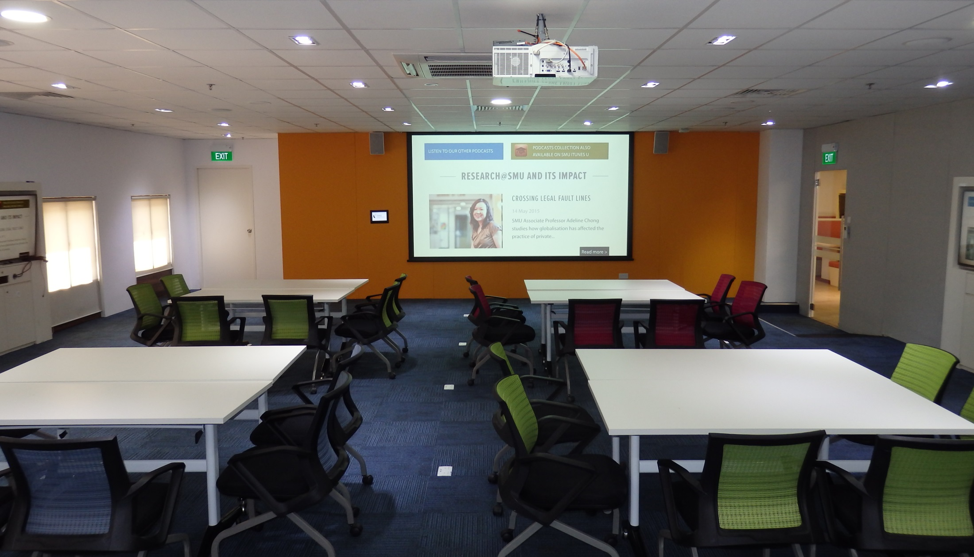
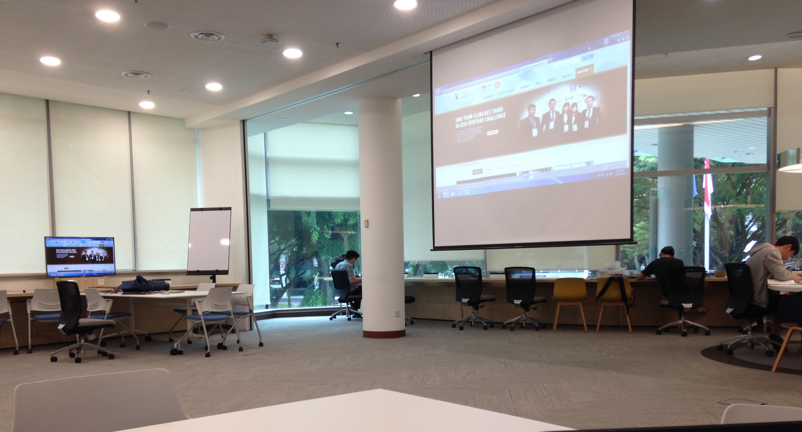
ACTIVE LEARNING CLASsroom

Slide 7
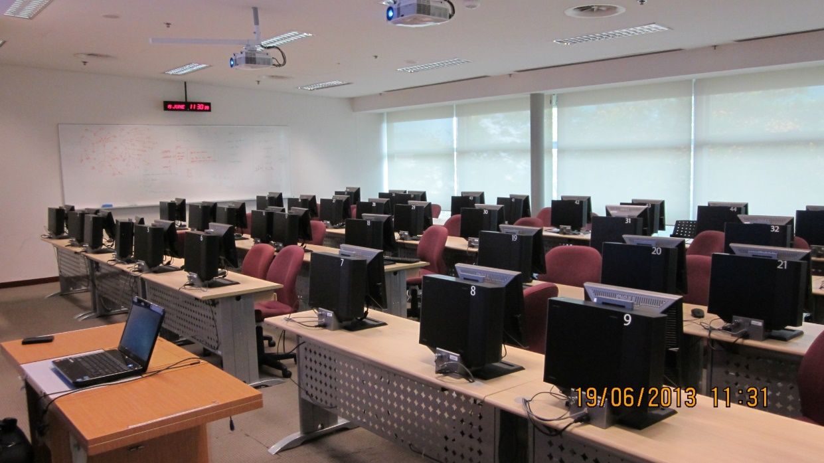
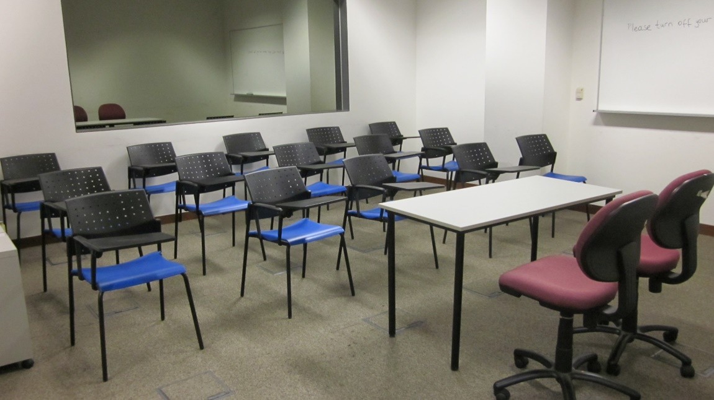
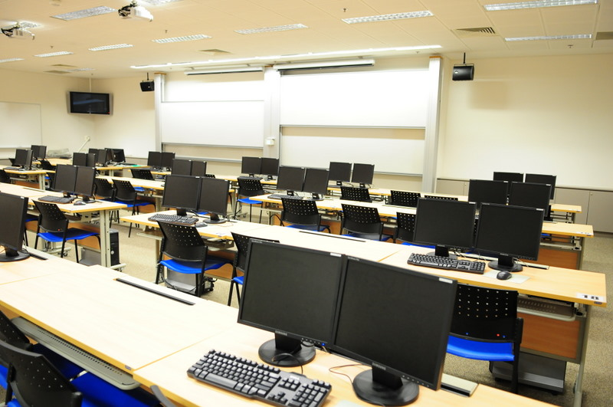
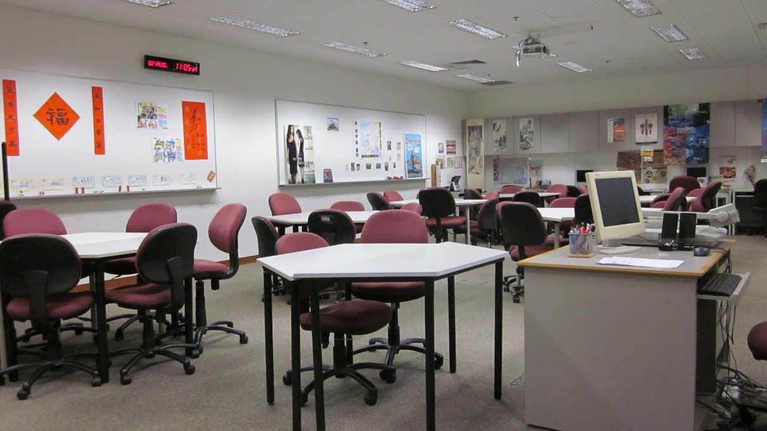
LAbs

Slide 8
Auditorium

Slide 9
Function Halls 1400 seaters

Slide 10
What is available at the Lectern Table?
Input points for Laptop 1 / Laptop 2
Lectern PC / Closet PC
Doc Camera
DVD Player

Slide 11
Campus map
Main Campus
SMUC +
YPHSL

Slide 12
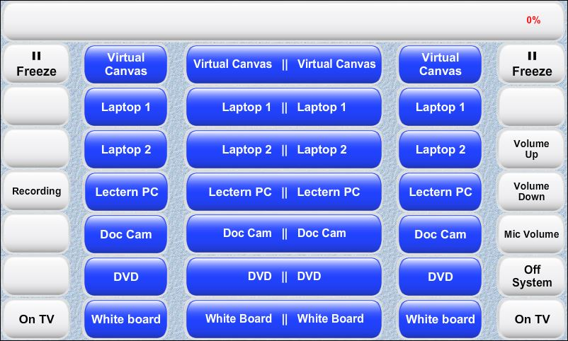
Touch Panel

Slide 13
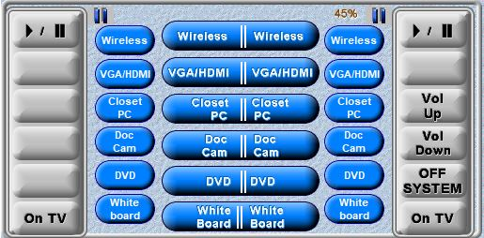
Touch Panel

Slide 14
Projector Screen A
Projector Screen B
LAPTOP 1
LAPTOP 1
PRESS

Slide 15
Projector Screen A
Projector Screen B
LAPTOP 1
LECTERN PC
SELECTED
PRESS

Slide 16
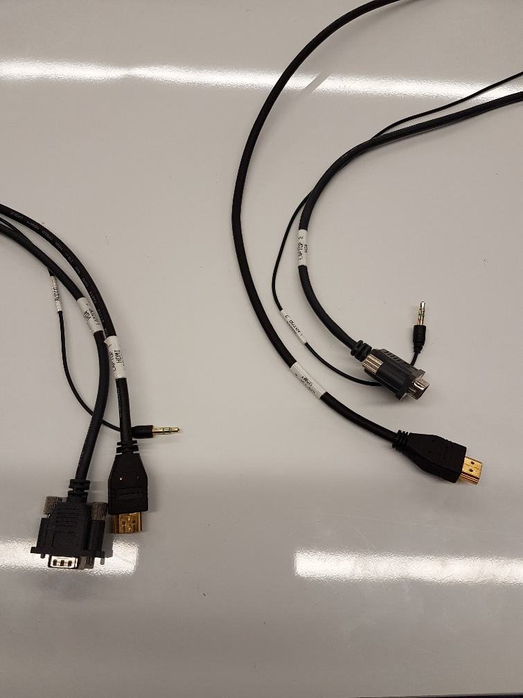
At any one time, only 1 video cable
(VGA or HDMI) from 1 Side can be connected to your laptop
2 HDMI Cables
2 VGA Cables
2 Audio Cables

Slide 17
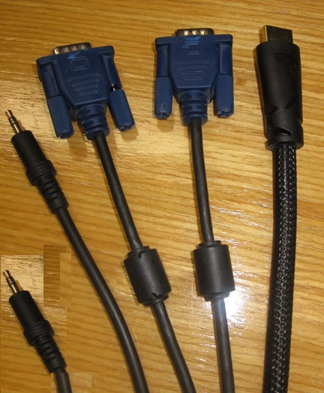
On the Lectern Table
1 HDMI Cable
1 VGA Cable
1 Audio Cable
At any one time, only 1 video cable
(VGA or HDMI) can be connected to your laptop
Audio IN
Audio Out
VGA
HDMI

Slide 18
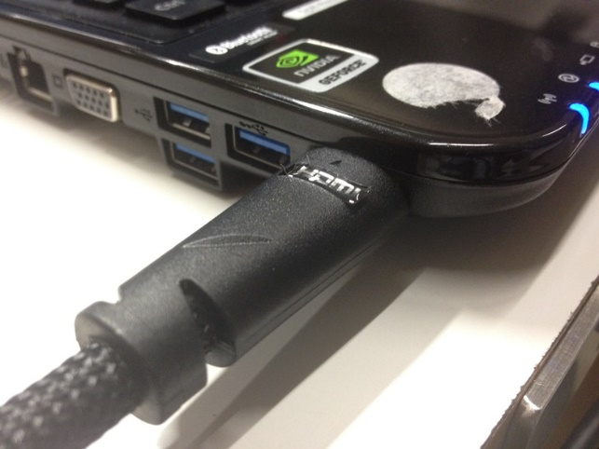
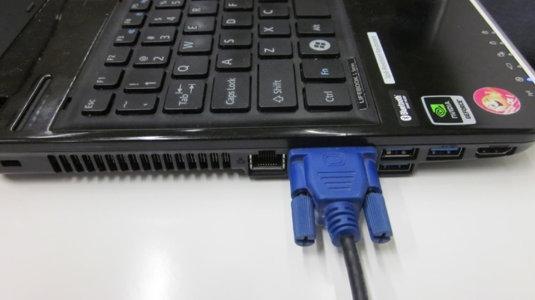
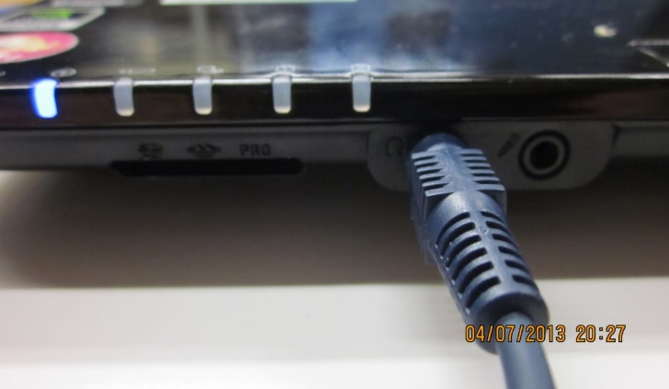
HDMI – Plug in HDMI cable to HDMI port
- 1 single cable transmits both Video & Audio Signal
VGA – Connect VGA cable to VGA port
Sound - Plug audio cable to headset port

Slide 19
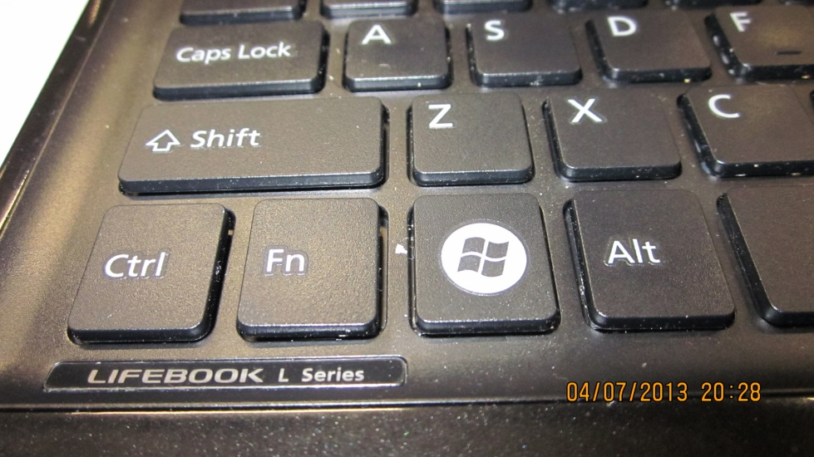
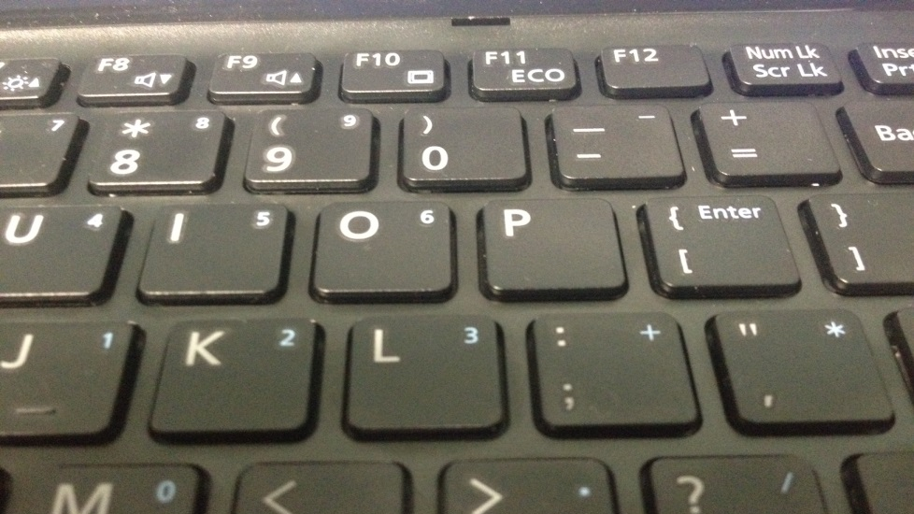
To display your Laptop to Projector

Slide 20
Lectern PC
Located at the Lectern
Wireless Keyboard and Mouse

Slide 21
CLASSROOM PC
Wireless Keyboard and Mouse
Are located in the Equipment Rack

Slide 22
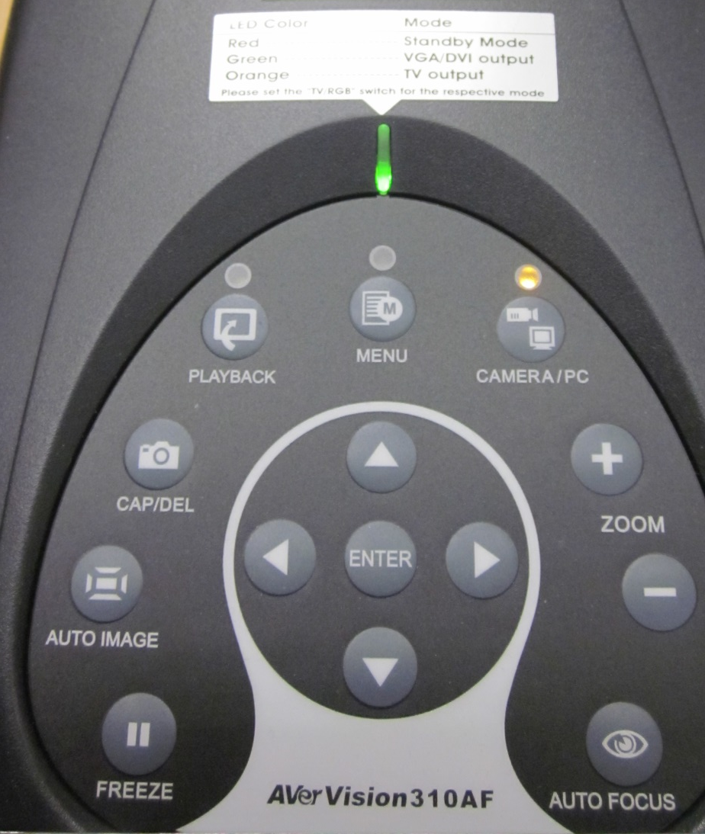
DOCUMENT CAMERA
PRESS TO ZOOM IN
PRESS TO ZOOM OUT
PRESS TO FOCUS

Slide 23
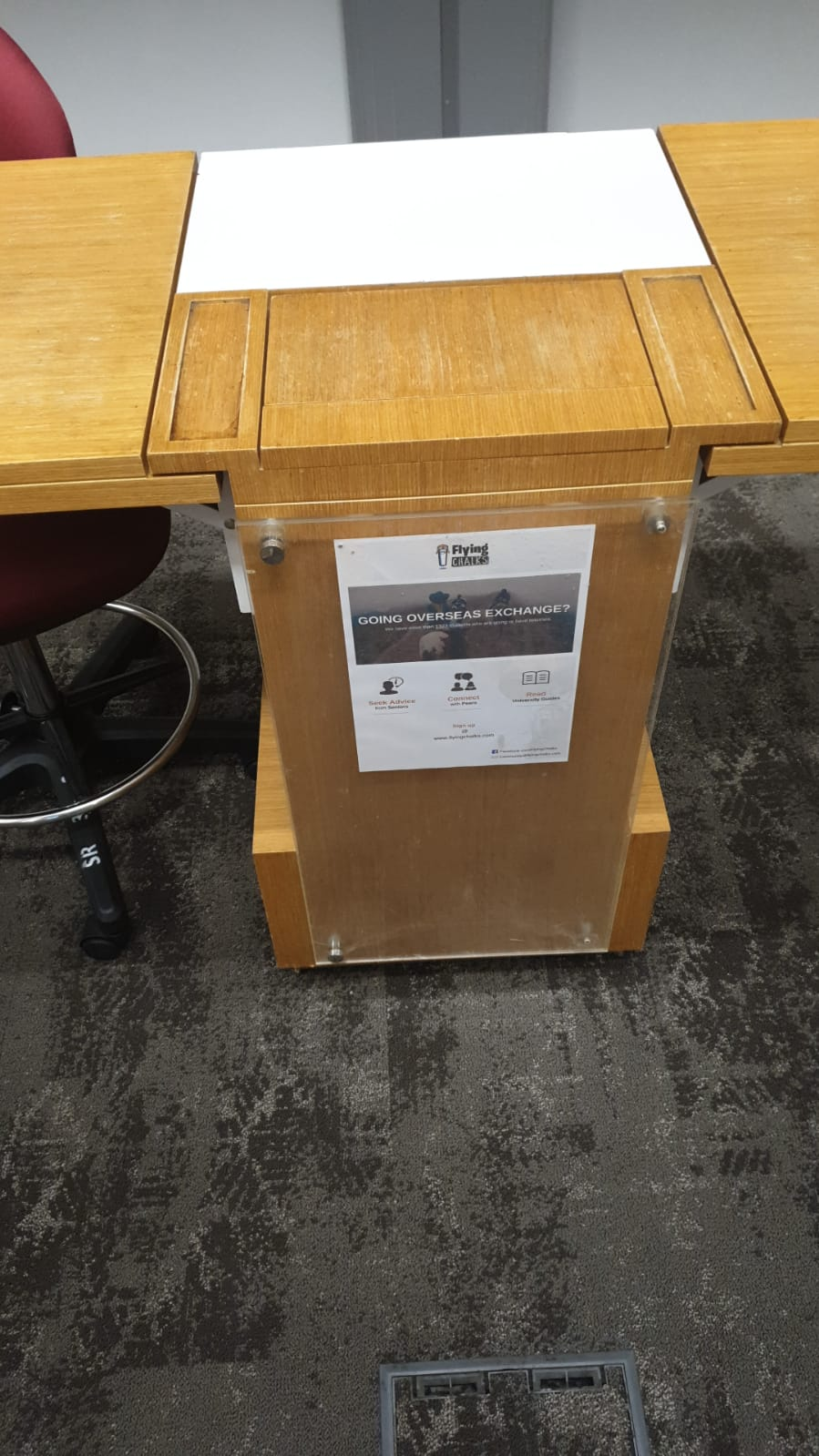
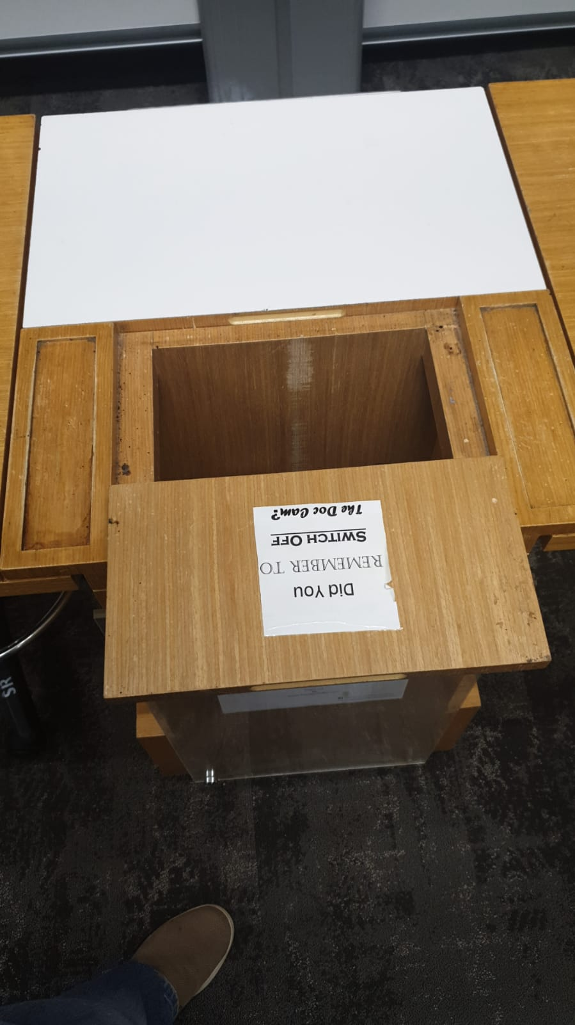
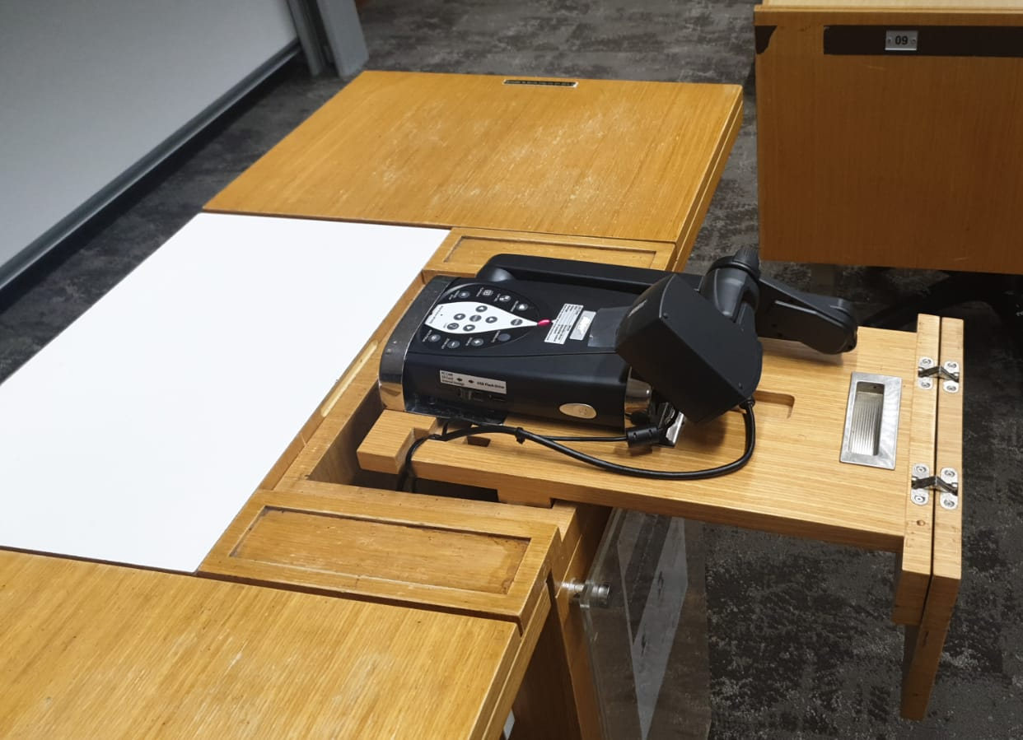
DOCUMENT CAMERA

Slide 24
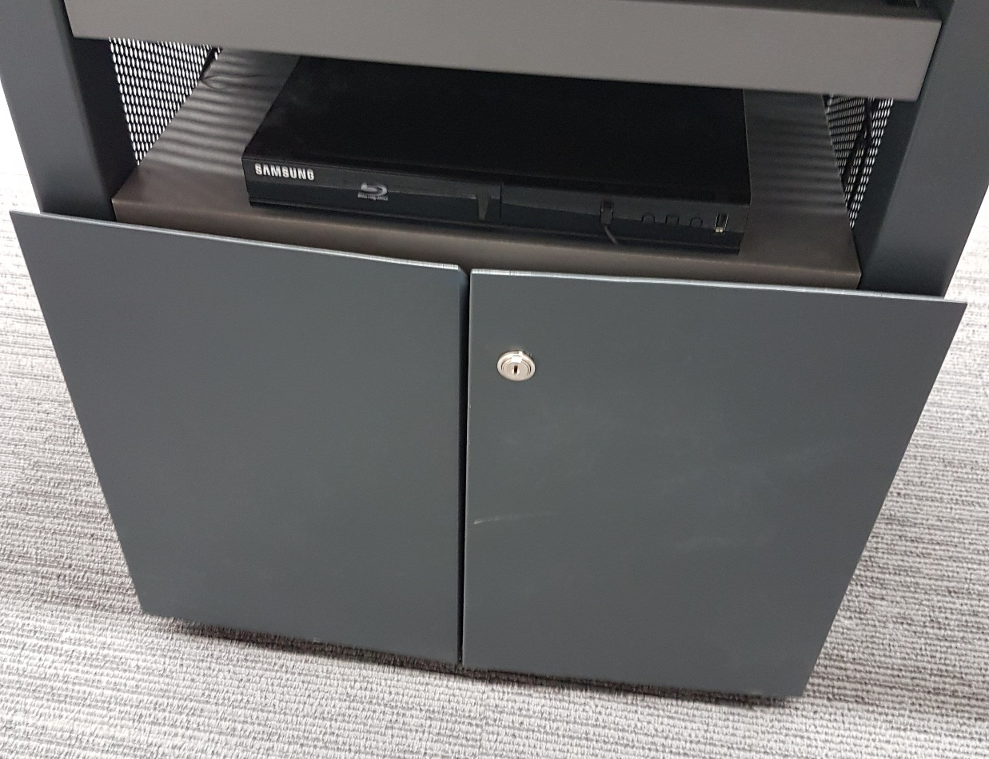
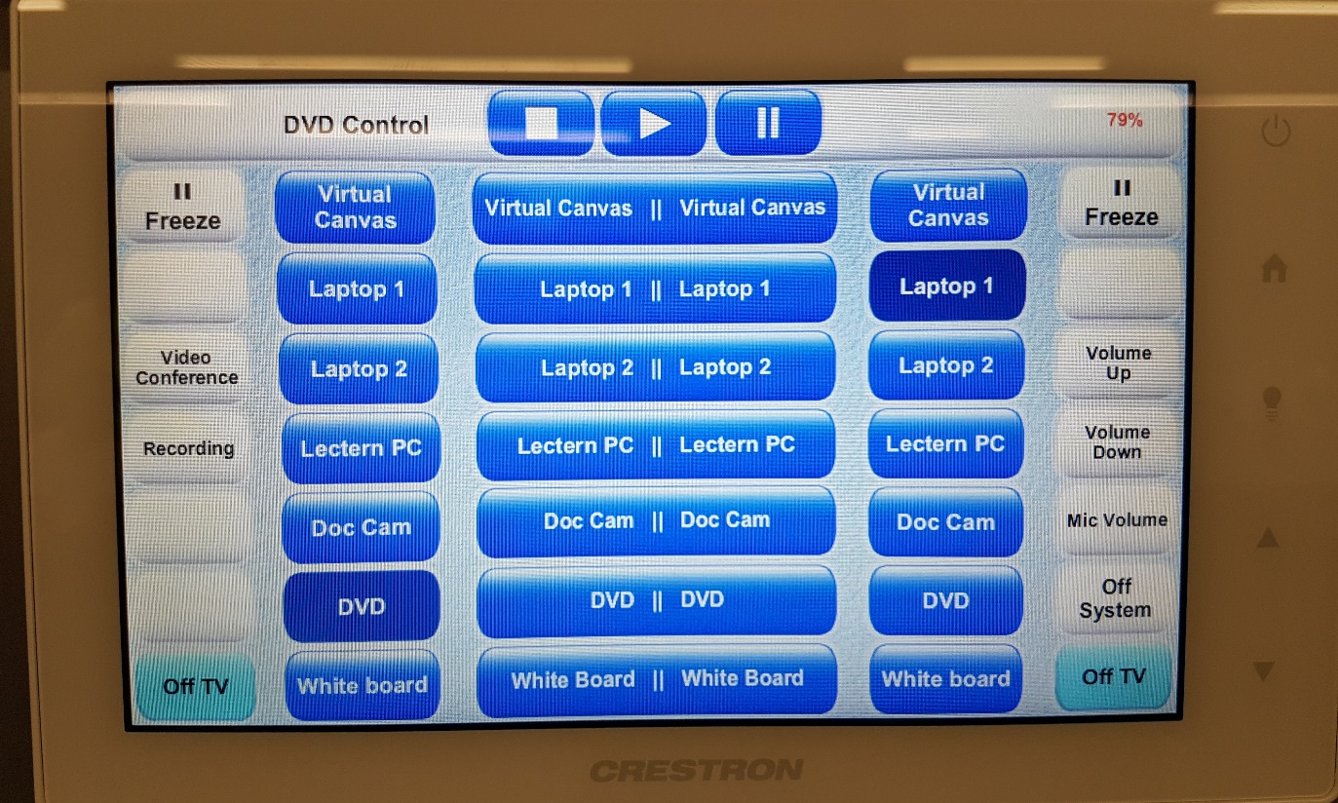
DVD Player

Slide 25
DVD Player
Region Free
Remote control is found in Equipment Closet
Blu-ray not supported at moment

Slide 26
Whiteboard & light
Please get your whiteboard markers/duster from your school admin
NOTE: Switching to whiteboard mode does not turn off our projectors

Slide 27
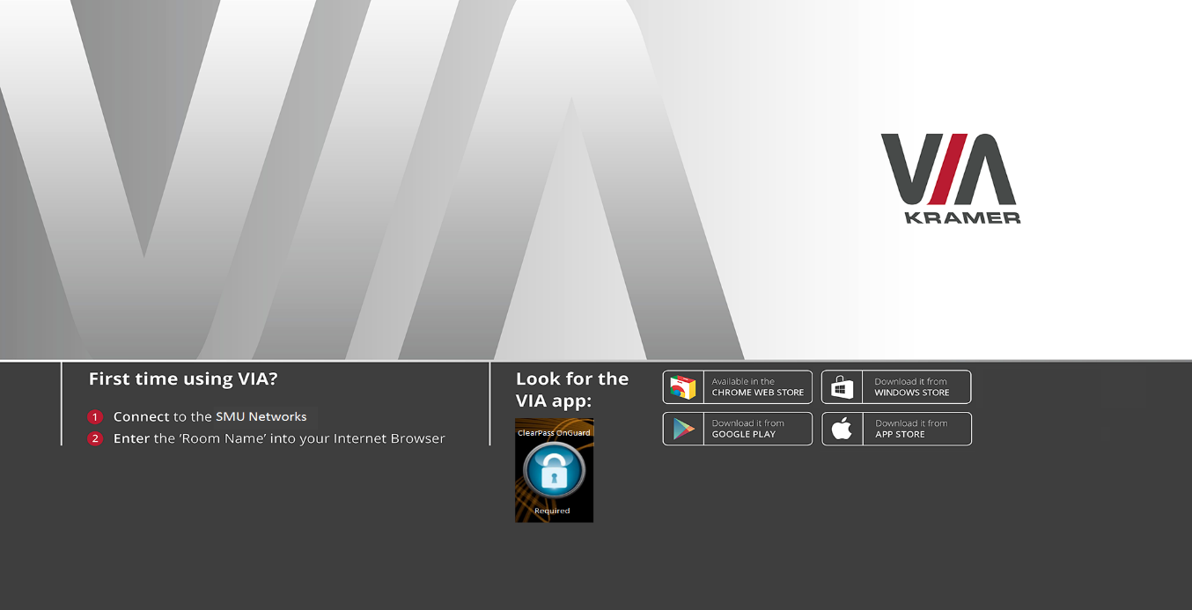
Wireless Projection
Room Name : 10.X.XX.XX
Code : XXXX

Slide 28
Wireless Mic
Wireless Microphone
Do not coil the wires or tap on the microphone
Please switch off after use

Slide 29
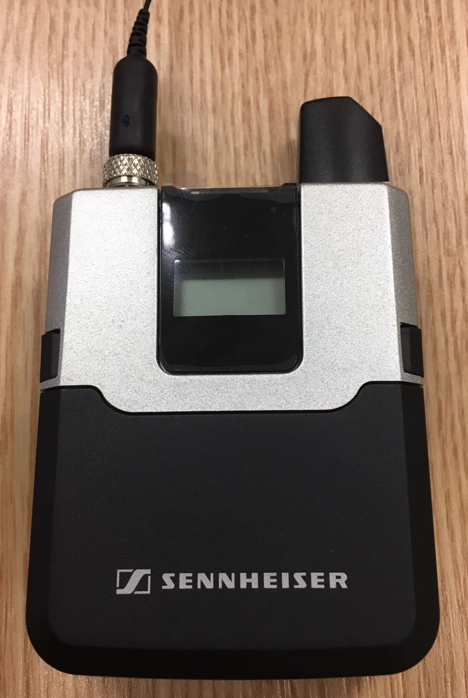
Wireless Mic
Wireless Microphone
Do not coil the wires or tap on the microphone.
Please put back the microphone into the charging back after use.
Back

Slide 30
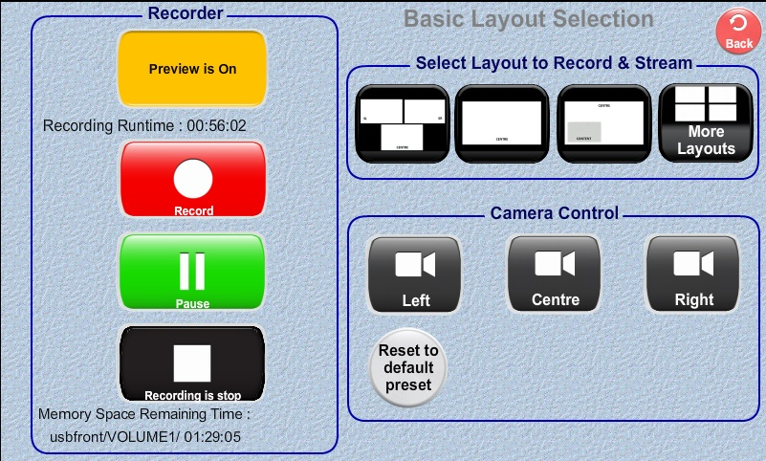
Self Help Recording

Slide 31
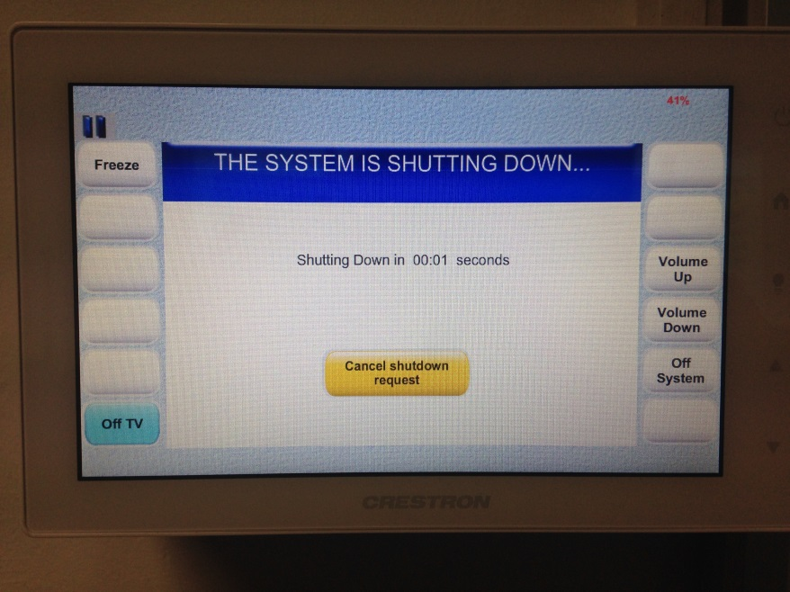
Switching off the projection system
End of your class, press OFF button to turn off the system

Slide 32
Getting HELP

Slide 33
Getting HELP
IITS Help Center
Contact No: 68280123 (ext. 0123)
Email Address: helpdesk@smu.edu.sg
IITS Help Center located at SoA Basement 1
(beside SoA lift)
Operating Hours: Monday – Friday (8.30am – 7.00pm)
Last walk-in 6:30pm
Closed on Weekends & Public Holidays

Slide 34
Single point of contact: Helpdesk
6828 0123, Email Address: helpdesk@smu.edu.sg
Jan Setyawan (Senior Assistant Director )
6828 0692, Email: jansetyawan@smu.edu.sg
Wilson Lam (Senior Associate Director)
6828 0129, Email: wilsonlam@smu.edu.sg
Contact us
Problems, Requests and Innovations/Ideas

Slide 35
Questions?

Slide 36
Summary
Brief Overview of Rooms
Starting Up
Touch Panel
Lectern’s Equipment
Microphone
Shutting Down
Getting HELP
Suggestions
Other Important notes

Slide 37
Thank you

