Slide 1
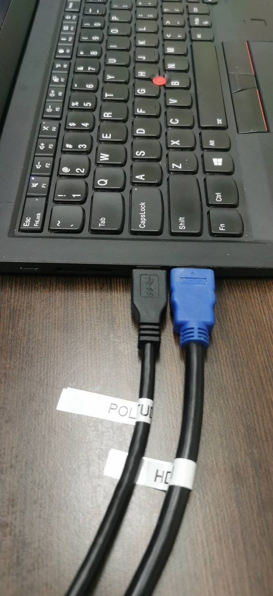
Getting Started
USB
HDMI
Connect the following 2 cables from table to your laptop
(i) HDMI (Blue)
For projecting to the TV
(ii) USB (Black)
For connecting to Poly Studio
Locate & plug to your laptop

Slide 2
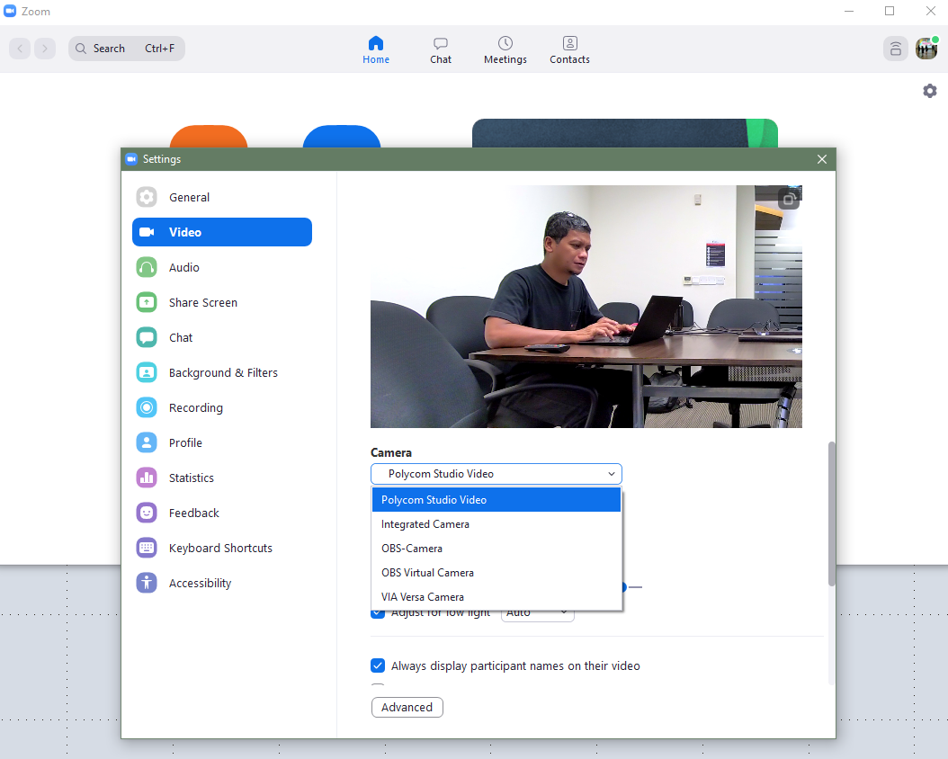
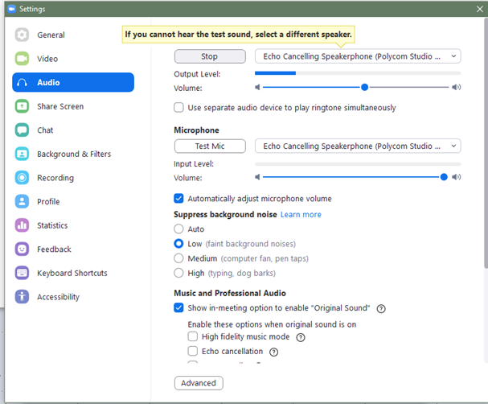
2. At video setting of Zoom or MS Teams,
Select Poly Studio
3. At audio setting of Zoom or MS Teams,
Select Poly Studio

